Slide 1
ASE Scenarios
Scenario 3
ASE User views Attack Surface Information

Slide 2
Roles
Developer
Tester
Risk Manager
Notes:
I am excluding build manager from this scenario because their discovery is via SDK only.

Slide 3
Goals
User browses information contained in an ASE Profile in order to understand the Test Application’s Attack Surface

Slide 4
Steps
Step 1: Selecting the ASE Profile to use
Step 2: Browsing the Attack Tree View
Step 3: Browsing the Attack Map View

Slide 5
Step 1
Selecting the ASE Profile to use
User selects an ASE Profile from the Solution Explorer
User dbl-clicks on Attack Surface node of selected Profile

Slide 6
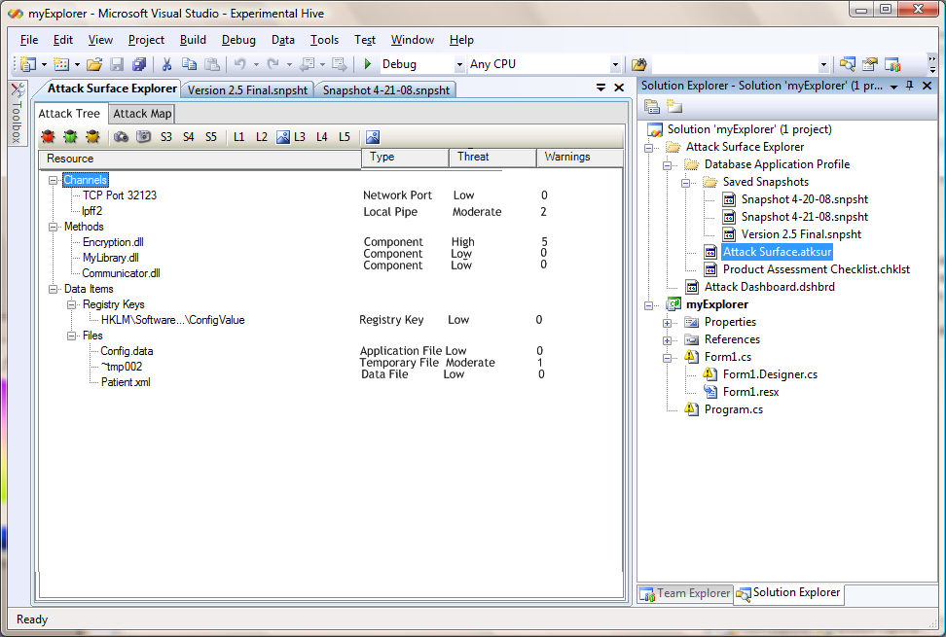
Step 2
Browsing the Attack Tree View
User expands and collapses items in tree
User enters text in search box to find matching items
User selects filter to view selective information such as:
Show resources marked Critical only
Hide items marked ‘No Risk’
…

Slide 7
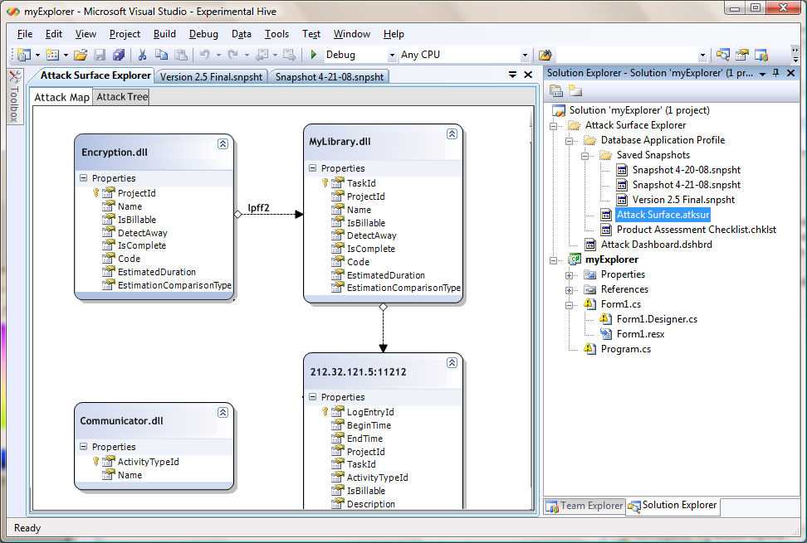
Step 3
Browsing the Attack Map view
User interacts with objects in Map
Move object position
Group objects together
User can use search and filters like the Attack Tree

